Slide 1

INNOTRACK INTERNSHIP PROGRAM - 2026
Name:G.SriVarshini
Project Name: Social sentiment&Trend predictor
Theme:Artificial Intelligence & Machine Learning (AI/ML)
VTU ID: VTU28014

Slide 2
Social Sentiment & Trend Predictor
INTRODUCTION:
Social media has become one of the largest platforms where people express their opinions, experiences, and feedback every day. Analyzing this huge volume of data manually is time-consuming and inefficient.
The Social Sentiment & Trend Predictor is an Artificial Intelligence (AI) and Machine Learning (ML) based web application that uses Natural Language Processing (NLP) to analyze social media text and classify it into Positive, Negative, Neutral, or Irrelevant sentiments. Built using Flask, the system provides fast, accurate, and user-friendly sentiment prediction, helping businesses, researchers, and organizations understand public opinion and identify emerging trends for better decision-making.

Slide 3
Idea and solution:
Idea:
Develop an intelligent web application that automatically analyzes social media posts and identifies the sentiment expressed by users. The system helps understand customer opinions, public feedback, and trending discussions without manual analysis.
Solution:
The proposed solution uses Natural Language Processing (NLP) and Machine Learning techniques to process social media text and classify sentiments into Positive, Negative, Neutral, and Irrelevant categories. Users submit text through a Flask web application, where it is analyzed instantly and the prediction is displayed. The system also stores prediction history for future reference.
Uniqueness:
✔ AI-powered sentiment analysis using NLP
✔ Flask-based responsive web application
✔ TF-IDF Vectorizer with Logistic Regression model
✔ Four-class sentiment classification
✔ Secure user authentication and login system
✔ Prediction history stored using SQLite
✔ Lightweight, scalable, and cloud deployable.

Slide 4
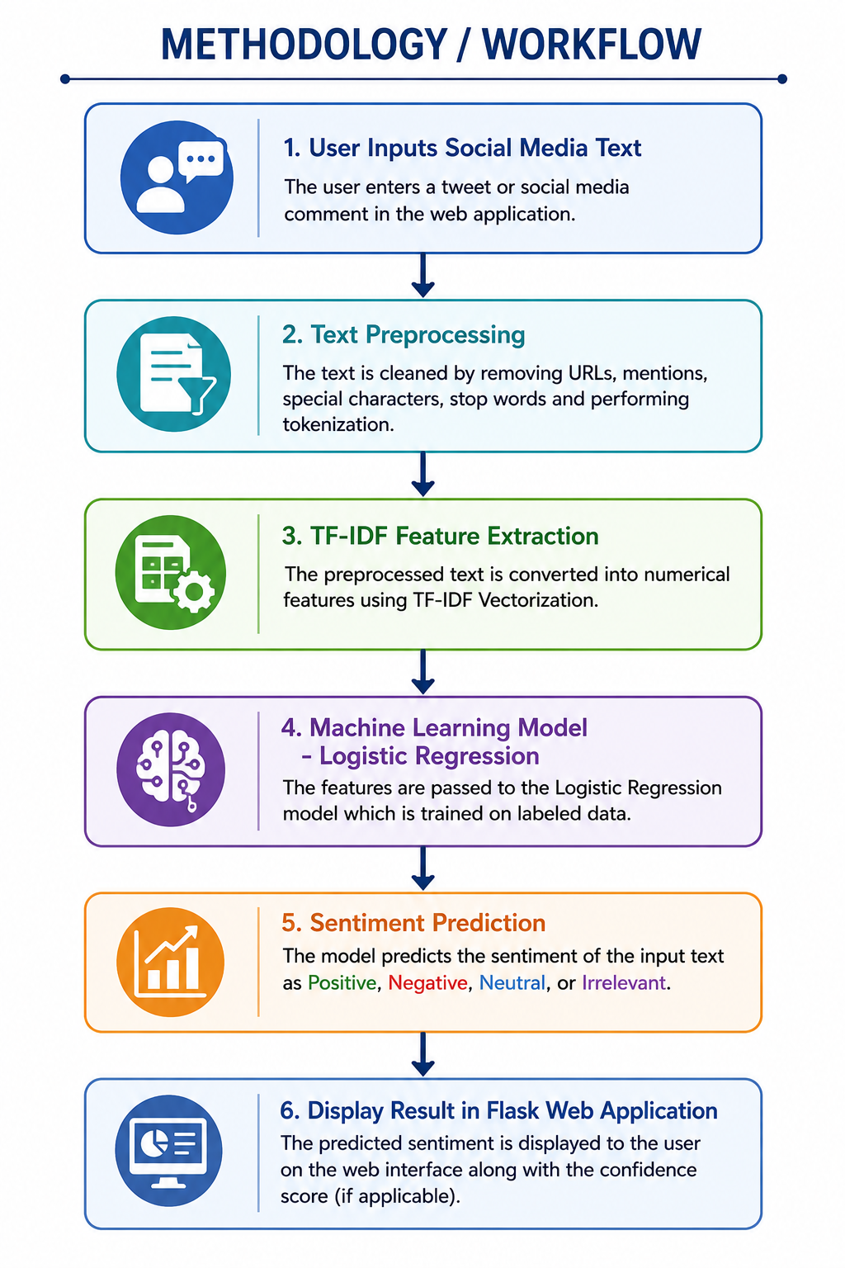
TECHNICAL APPROACH
Technologies to be Used:
Frontend: HTML, CSS, JavaScript
Backend: Python, Flask
ML: NLP, TF-IDF, Logistic Regression
Database: SQLite
Deployment: GitHub, Render
Methodology:
User Input → NLP Preprocessing →
TF-IDF → Logistic Regression → Sentiment Prediction → SQLite Database → Result & History

Slide 5
FEASIBILITY AND VIABILITY
Feasibility and Viability:
Technical Feasibility:
Uses proven technologies such as Python, Flask, Scikit-learn, and SQLite.
Machine Learning and NLP enable accurate and efficient sentiment prediction.
Easy to deploy on cloud platforms like Render.
Operational Feasibility:
Simple, user-friendly web interface.
Requires minimal training to use.
Provides quick sentiment analysis and prediction results.
Economic Feasibility:
Built using free and open-source technologies.
Low development and maintenance cost.
Suitable for students, startups, and small businesses.

Slide 6
CHALLENGES FACED
Challenges:
• Collecting noisy and unstructured social media data
• Cleaning URLs, emojis, stop words, and special characters
• Improving Machine Learning model accuracy
• Integrating the trained model with Flask
• Managing user authentication and prediction history
• Deploying the application successfully on Render
How We Overcame These Challenges:
✔ Applied NLP preprocessing techniques
✔ Used TF-IDF for effective feature extraction
✔ Selected Logistic Regression for reliable classification
✔ Performed continuous testing and debugging
✔ Successfully deployed the application after resolving dependency issues.

Slide 7
FUTURE ENHANCEMENTS
✔ Integrate real-time social media APIs (X/Twitter).
✔ Improve accuracy using Deep Learning models (LSTM/BERT).
✔ Support multilingual sentiment analysis.
✔ Develop an interactive analytics dashboard.
✔ Predict trending topics and public opinion changes.
✔ Enhance cloud security and scalability.
✔ Develop a mobile application for real-time monitoring.

Slide 8
IMPACT AND BENEFITS
Impacts:
✔ Automated analysis of social media sentiment
✔ Helps businesses understand customer opinions
✔ Demonstrates real-world application of AI, ML, and NLP
✔ Supports data-driven decision-making
Benefits:
✔ Reduces manual effort and analysis time
✔ Provides fast and reliable sentiment predictions
✔ Easy-to-use web application
✔ Cost-effective solution using open-source technologies
✔ Can be extended for product reviews, brand monitoring, and customer feedback analysis.

Slide 9
CONCLUSION
The Social Sentiment & Trend Predictor successfully demonstrates the integration of Artificial Intelligence, Machine Learning, and Natural Language Processing to solve a real-world problem in sentiment analysis. By combining a Flask-based web application, secure user authentication, SQLite database integration, and an efficient Machine Learning model, the system provides accurate and reliable sentiment predictions. With future enhancements such as real-time social media integration, multilingual support, and advanced deep learning models, the application can evolve into a powerful platform for large-scale sentiment and trend analysis.

Slide 10
THANK YOU

